Slide 1
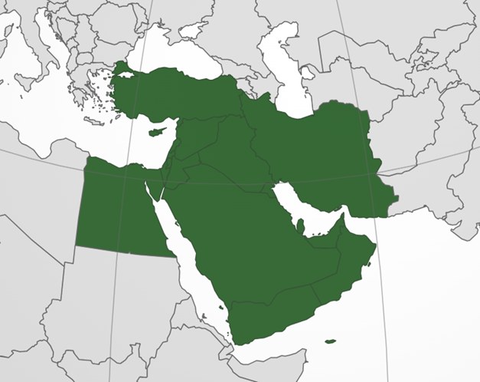
Transformation of Peering in Middle East
MENOG24, Muscat, Bernd Spiess
Source: https://upload.wikimedia.org/wikipedia/commons/3/3f/Middle_East_%28orthographic_projection%29.svg, 4.11.2024

Slide 2
5 Main Topics:
PNI Peering
IXP Peering - Status Report
Looking at embedded Caches
Peering Preventing Issues in Middle East
Missing Peering examples

Slide 3
Part 1: PNI Peering

Slide 4
Part 1: PNI Peering
Hyperscaler peer main traffic via PNI
Ratio can be 90%+ over PNI for them
We assume many Tbit per hyperscaler per Pop
This is a major part of Internet traffic exchange
These POPs typically utilize their IXP connects
Question: are they in Middle East?

Slide 5
PNI Map
Massive PNI
presence!
My data is
best effort!
Yes, this is
quite a
progress!

Slide 6
Interesting to Mention
Not everyone is everywhere!
Reaching those locations crossing borders is a massive cost challenge. => see Part 5!
Some countries have nothing at all!
Big density seen in BH/AE/QA/OM

Slide 7
Part 2: IXP Peering - Status Report

Slide 8
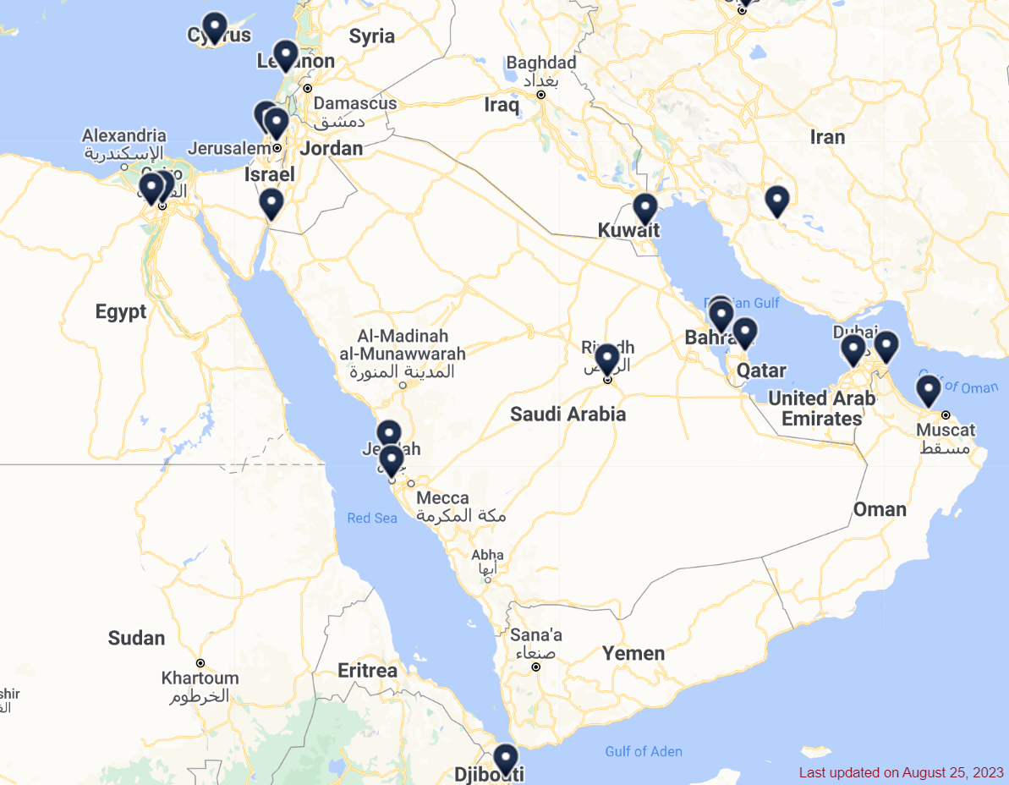
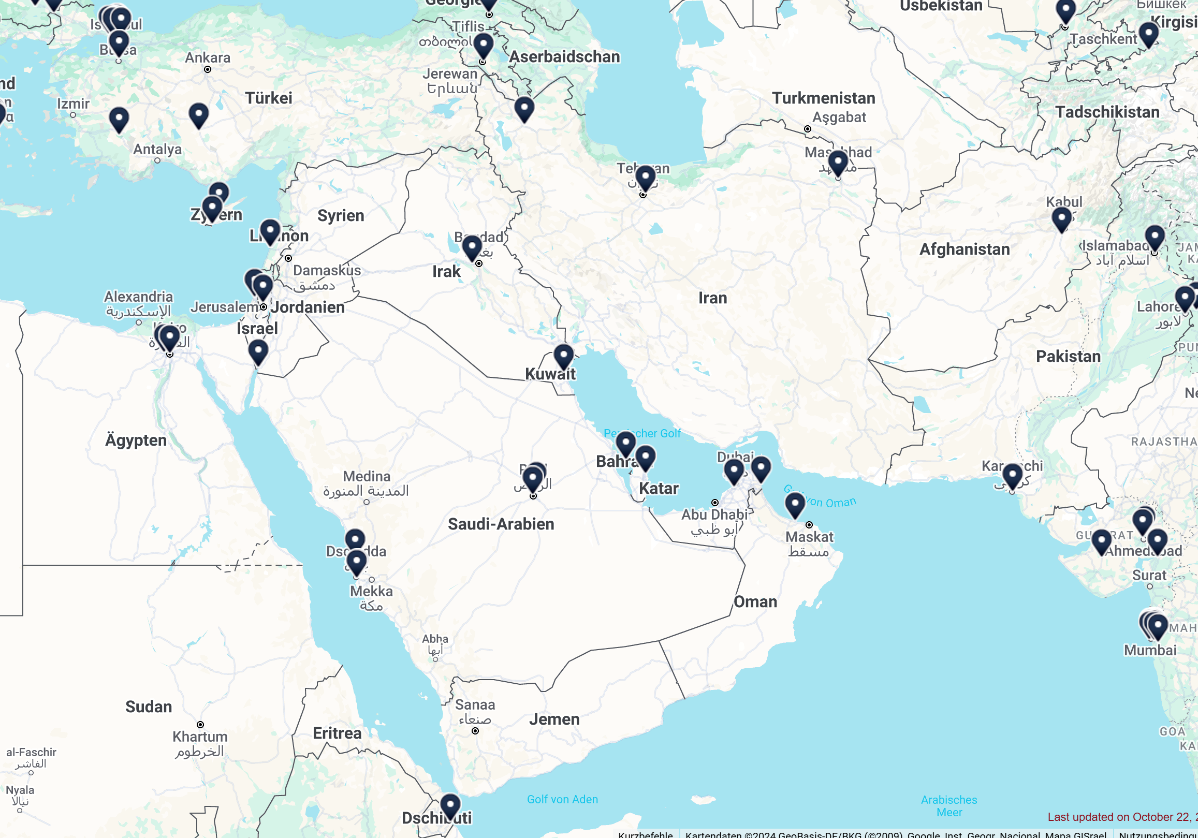
Changes of the Peering Landscape in ME++?
2023 vs. 2024
New: Iraq-IXP⁽³⁾, Riyadh IX⁽²⁾, PIE⁽³⁾, Oman-IX⁽¹⁾
Source : https://www.internetexchangemap.com
(1) powered by AMS-IX
(2) powered by LINX
(3) powered by DE-CIX

Slide 9
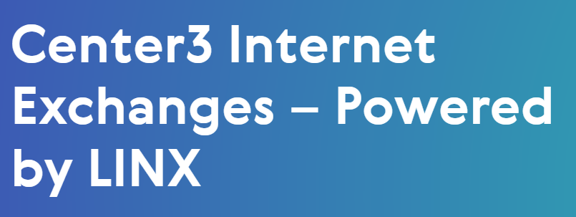
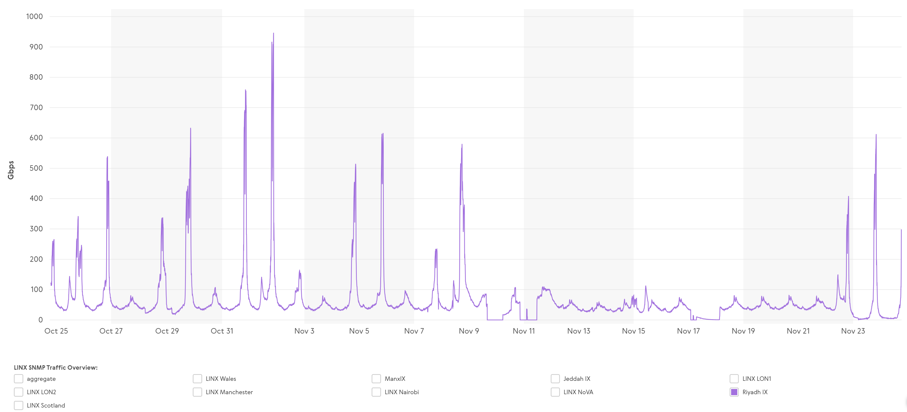
Highlighting Riyadh IX by LINX
Started in
July 24
Reached 950
Gbps in Nov!

Slide 10
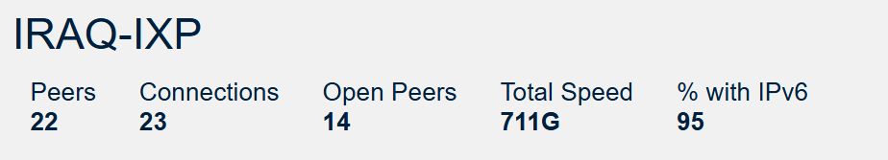
Highlighting IraqIXP
Started in 2024
Reached > 20 Gbps Peak in Nov

Slide 11
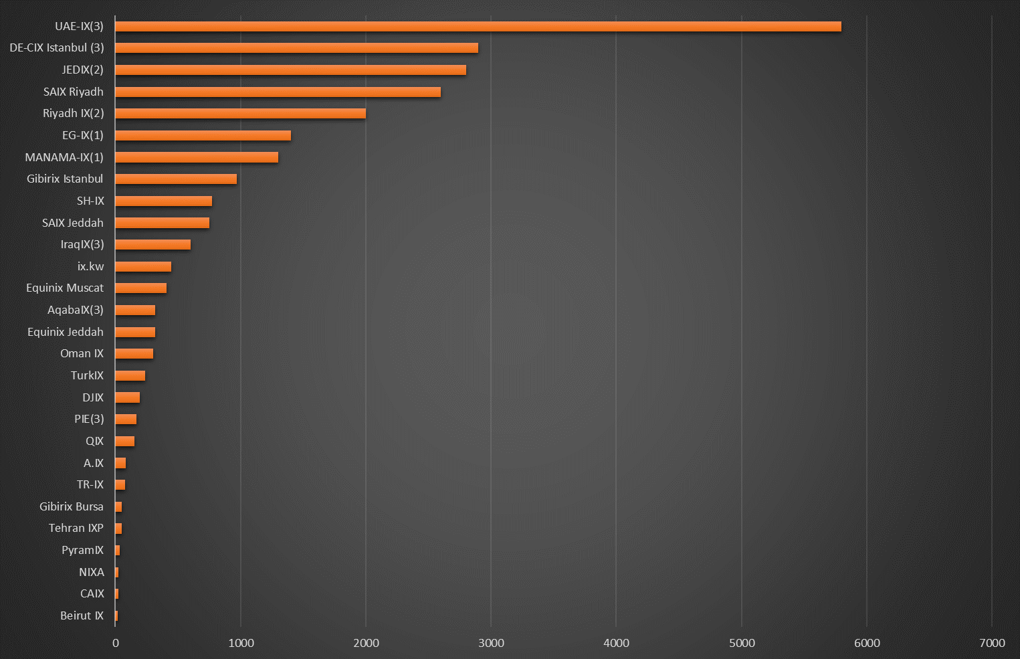
ME IXP Overview - Capacities
(source: peeringdb.com + overwrite with real data from homepage or known data, data from: 4.11.2023, ixp >= 3 peers)
(1) powered by AMS-IX
(2) powered by LINX
(3) powered by DE-CIX

Slide 12
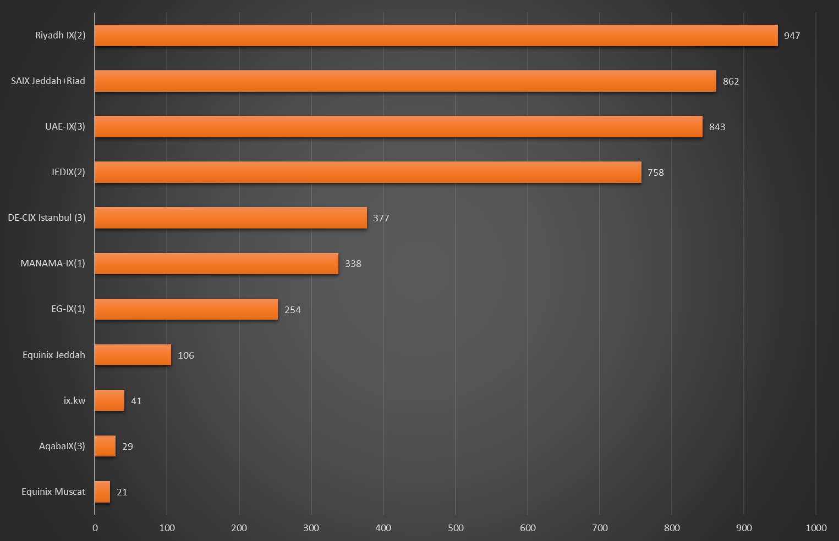
ME IXP Overview – Peak Traffic
(source: homepages => all time peak - where available, data from: 4.11.2023, ixp >= 3 peers)
(1) powered by AMS-IX
(2) powered by LINX
(3) powered by DE-CIX

Slide 13
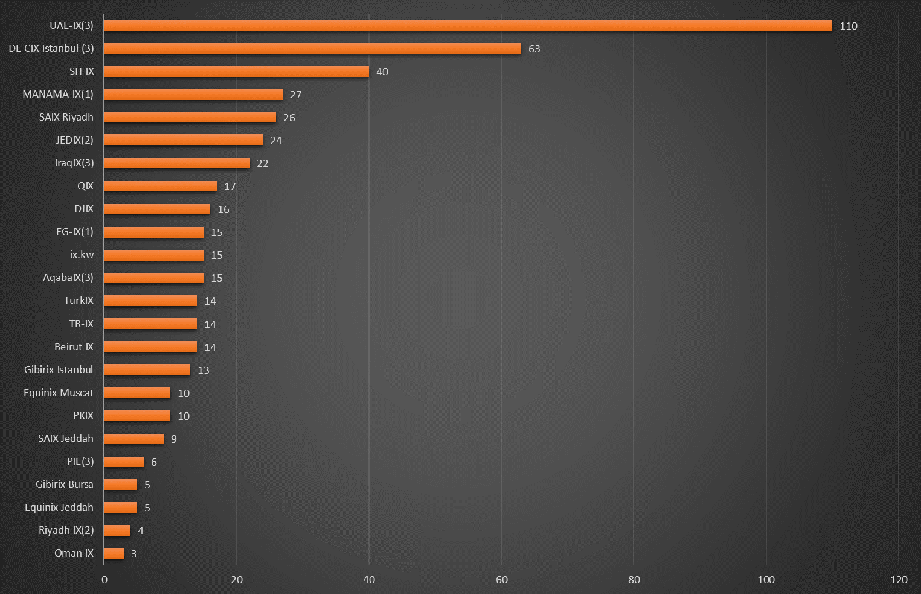
ME IXP Overview – Connected ASN
(source: peeringdb.com + overwrite with real data from homepage or known data, data from: 4.11.2023, ixp >= 3 peers)
(1) powered by AMS-IX
(2) powered by LINX
(3) powered by DE-CIX

Slide 14
Part 3: Looking at embedded Caches

Slide 15
Part 3: embedded Caches
Caches are put into ISP´s networks on base of alignments between ISP+content provider.
Cache hit ratio is very high for static content.
Cache feed typically comes from the ISP.
This is a major part of Internet traffic supply!
Question: are they in Middle East?

Slide 16
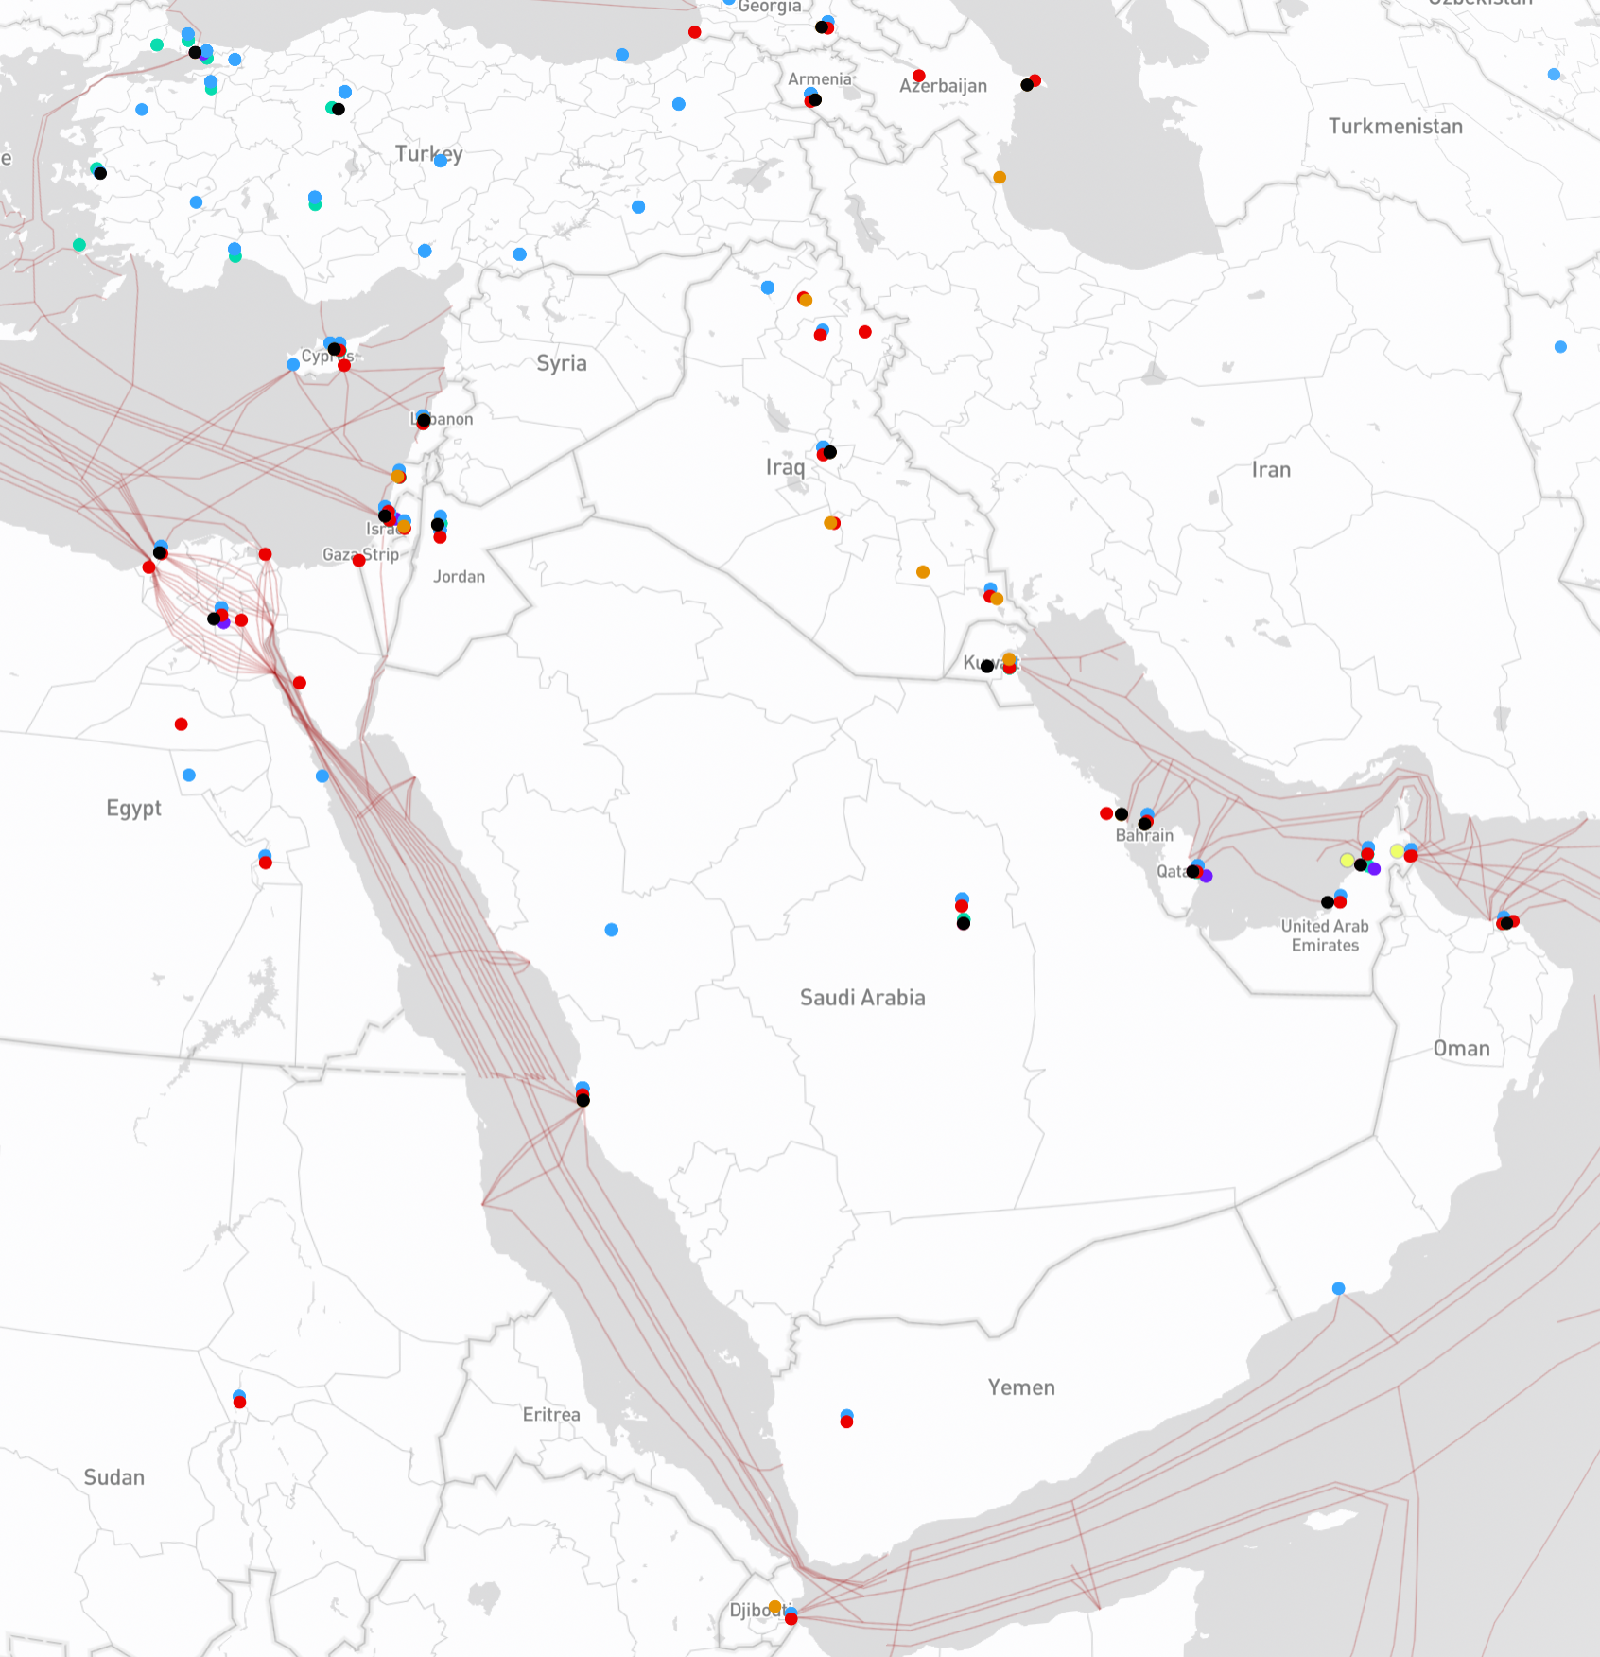
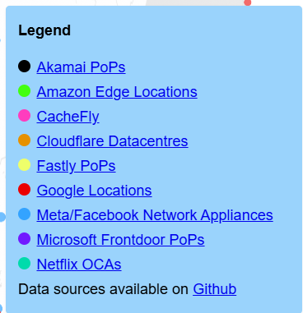
Cache Map
Massive cache
presence!
Yes, this is
quite a
progress!
Cache feed via
transit or IXP
Source: https://opentelecomdata.org/cdns/

Slide 17
Interesting to Mention
Sanctioned countries have nothing at all!
Big density seen in most countries!
But: Not every CDN is in each country!
Cache fill might come from Europe or Singapore in case there is no PNI in-region!

Slide 18
Part 4: Peering Preventing Issues in Middle East

Slide 19
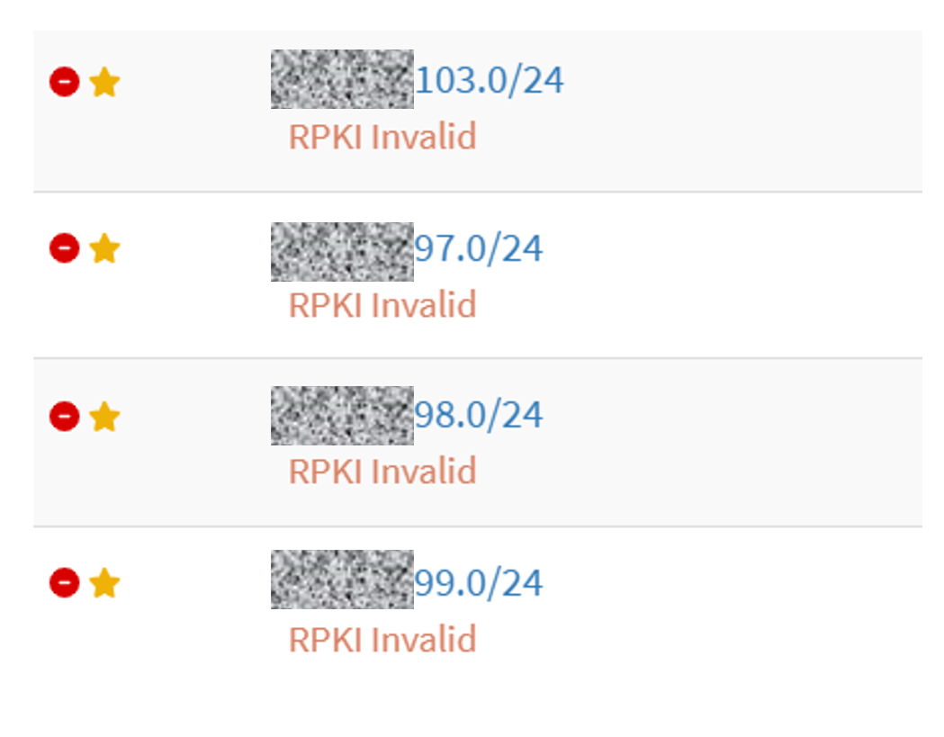
a) Too less RPKI competence = no traffic

Slide 20
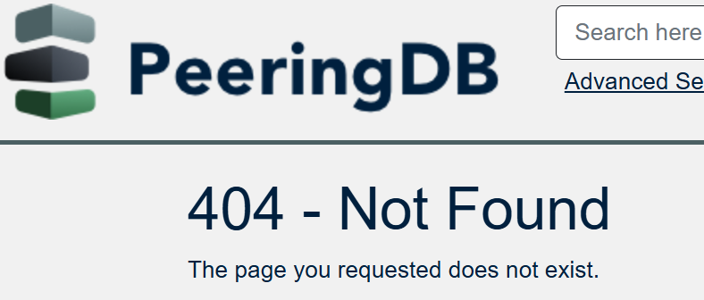
b) No PeeringDB = no chance

Slide 21
c) Buy or Rent of Dark Fiber
Example Europe:
yes, here you go – it costs 0.xy Cent/Pair/m/y
Example Middle East: (typically)
No
Yes, but it costs a fortune
Question: other opinions?

Slide 22
d) 10G and 100G Wavelength Service
Example Prices Europe:
100G ~ 1K MRC
Example Middle East: (typically?)
Source: https://www.linkedin.com/posts/roderick-beck-94868948_dubais-rigged-telecom-market-i-have-received-activity-7262415118754344961-LLV3?utm_source=share&utm_medium=member_desktop, Posted: Mid Nov 24

Slide 23
d) 10G and 100G Wavelength Service
What does high wavelength prices mean?
International players stay away from your market.
Regional players stay away from your market.
Big IP traffic streams stay away from your market.
Local players cannot develop well.
Entrepreneurs will start elsewhere.
Your datacenter projects are having competitiveness issues.
Digital/Analog jobs will grow, but not in your country.

Slide 24
e) Layer-2 Capacity Offerings
Fictitious question from a potential customer:
“I need a Layer-2 Capacity from you”
Fictitious answer from national carriers:
“I don´t like to offer Layer2 – you can buy IP-Transit from me”

Slide 25
f) Hypotheses from the last slides
Someone in Dubai will not connect to Riad?
Someone in Riad will not connect to Muscat?
Someone in Bahrain will not connect to Doha?
All: hey, I better connect to MarFrAmsLon!
Etc… => Question can this be true?
Meanwhile in Europe: everyone connects everywhere with whatever capacity at no issues.

Slide 26
g) Influences of national Filters
I do respect the fact that filters are there!
But for developing a digital hub think about: e.g.:
  A country like XYZ shows 168 ASN registered, but only 2 of these are allowed to connect the XYZ IXPs.
  In contrast: Germany shows 3.515 ASN registered – all 3.515 ASN are allowed to connect all IXP in Germany and everywhere else.
Maybe filters need a conceptual innovation?

Slide 27
h) Governmental Taxes on Mbps
There are various traffic taxes in the region.
One example is $$$ on Mbps for IP Traffic in/out of the country (MOC fees).
International best-practice: traffic is coming via Layer-2!
You might decrease the competitiveness and performance and development and … of your country.

Slide 28
i) Not being allowed to connect regional IXP
Limiting connection to neighbor IXPs is like:
  close all border-crosses of all streets.
  shutdown direct flight routes.
  only allow passengers and good when they first travel out to Marseille/Singapore to be let passed in-country.
This might damage dramatically your performance, competitiveness and nat.security!

Slide 29
j) National IXP without a team
An IXP built on 1 or 2 persons
will fall apart
when these 1-2 persons move!
You lose many years in developments!

Slide 30
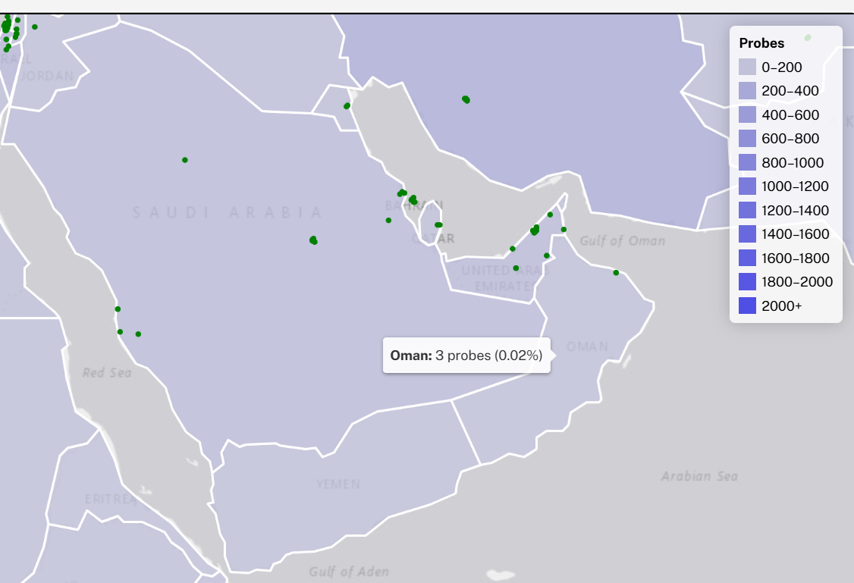
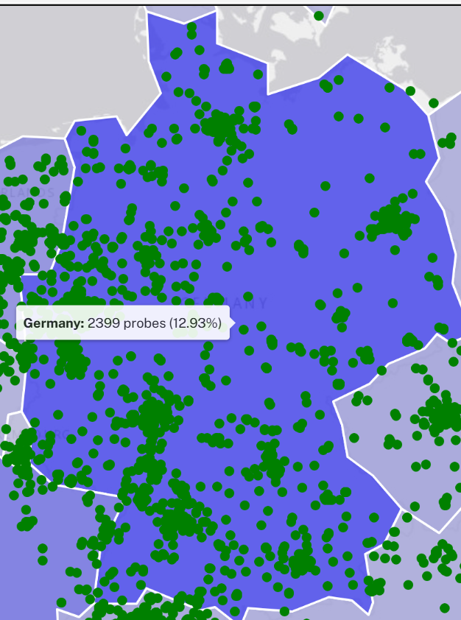
k) Transparency,
Tools Coverage
Probes count:
OM: 3
JO: 3
QA: 4
BH: 5
EG: 5
IQ: 11
SA: 28 ,AE: 29, TR: 97, IR: 156, IN: 270

Slide 31
Part 5: Missing Peering Examples

Slide 32
Some quick RTT Tests
Examples of outcomes when not working on the issues of Part 4.
Credits for IPv4 target examples: Anurag Bhatia
https://anuragbhatia.com/2022/07/networking/isp-column/facebook-cache-fna-updates-july-2022/
Finding these examples needs just 1 shot
Note: there are many good ones – I only show the bad ones here!

Slide 33
Example 1:

Slide 34
Example 2:

Slide 35
Example 3:

Slide 36
Learnings
The cause for these issues is not a lack of knowledge!
The issues are a result of the defined environment.
No, it does not make your country more secure!
No, it does not make your country more successful!

Slide 37
Suggestion:
Fix it or loose it.

Slide 38
Thank You!
bernd.spiess@de-cix.net

